Slide 1

Notes:
Welcome to this Organizational Behavior course that uses the 17th edition of the textbook, Organizational Behavior by Robbins and Judge. This is considered among the most widely used OB textbooks in the world. Robbins and Judge are recognized as definitive aggregators of OB concepts, applications, and practices. The course and this book will provide you with a resource that will benefit you throughout your degree program and your professional life.

Slide 2
3
Attitudes
and Job Satisfaction
Notes:
Chapter 3: Attitudes and Job Satisfaction

Slide 3
Learning Objectives
Contrast the three components of an attitude.
Summarize the relationship between attitudes and behavior.
Compare the major job attitudes.
Define job satisfaction.
Summarize the main causes of job satisfaction.
Identify three outcomes of job satisfaction.
Identify four employee responses to dissatisfaction.
Notes:
After studying this chapter, you should be able to:
Contrast the three components of an attitude.
Summarize the relationship between attitudes and behavior.
Compare the major job attitudes.
Define job satisfaction.
Summarize the main causes of job satisfaction.
Identify three outcomes of job satisfaction.
Identify four employee responses to dissatisfaction.

Slide 4

Contrast the Three Components of an Attitude
LO 1
Attitudes are evaluative statements—either favorable or unfavorable—about objects, people, or events.
They reflect how we feel about something.
3-4
Notes:
Attitudes are evaluative statements or judgments concerning objects, people, or events. They reflect how we feel about something. In other words, saying “I like my job”, reflects your attitude toward work.

Slide 5
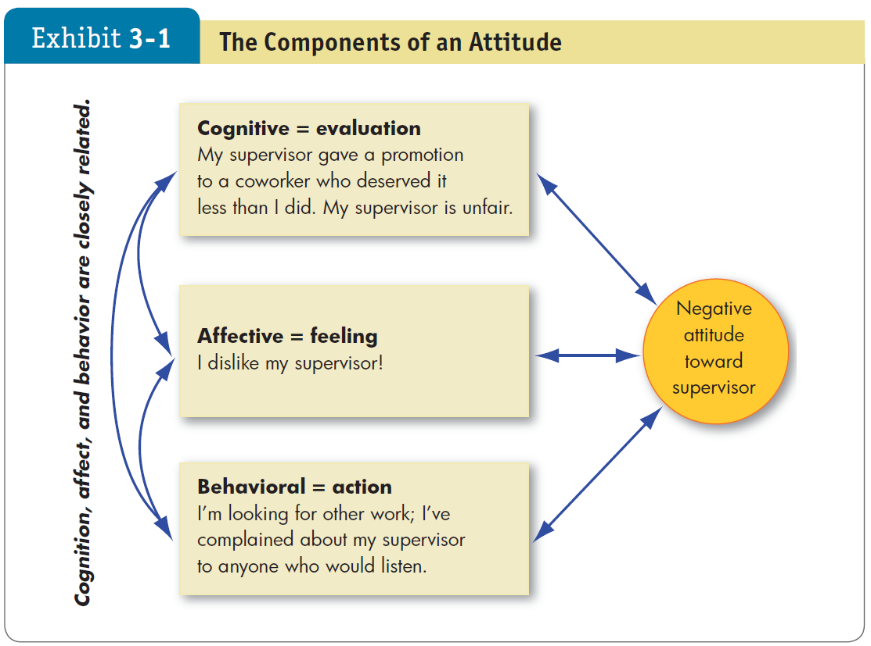


Contrast the Three Components of an Attitude
LO 1
3-5
Notes:
Attitudes are made up of three components. The cognitive component is the belief in the way things are. The affective component is the more critical part of the attitude, as it is calls upon emotions or feelings. The behavioral component describes the intention to behave in a certain way toward someone or something.
These three components work together to aid in our understanding of the complexity of an attitude.

Slide 6




Summarize the Relationship Between Attitudes and Behavior
LO 2
The attitudes that people hold determine what they do.
Festinger: cases of attitude following behavior illustrate the effects of cognitive dissonance.
Cognitive dissonance is any incompatibility an individual might perceive between two or more attitudes or between behavior and attitudes.
Research has generally concluded that people seek consistency among their attitudes and between their attitudes and their behavior.
3-6
Notes:
Early research assumed that attitudes were causally related to behavior. One researcher, Leon Festinger argued that attitudes follow behavior. Sometimes we observe people who will change what they say so it doesn’t contradict their behavior. When attitudes and behaviors don’t line up, individuals will experience cognitive dissonance. This incongruity is uncomfortable and individuals will seek to reduce the dissonance to find consistency.
People are willing to live with some discomfort, but the degree to which this is true depends on the importance of the elements, how much influence the individual has on the situation, and the rewards available.
Social sharing: helped workers adjust their attitudes to behavioral expectations.

Slide 7





Summarize the Relationship Between Attitudes and Behavior
LO 2
Moderating Variables:
Attitude’s importance
Correspondence to behavior
Accessibility
Presence of social pressures
Whether a person has direct
experience with the attitude
The attitude-behavior relationship is likely to be much stronger if an attitude refers to something with which we have direct personal experience.
Attitude
predicts
Mitigating Variables
Behavior
Notes:
Some variables moderate the relationship between attitude and behavior. These variables include the importance of the attitude to the person, the correspondence of the attitude to the behavior, the accessibility of the attitude, the presence of social pressures on behavior, and the direct experience a person has with the attitude. These mitigating variables will affect whether or not and to what degree a certain attitude will predict behavior.
Finally, the attitude-behavior relationship is likely to be much stronger if an attitude refers to something with which we have direct personal experience.

Slide 8










Compare the Major Job Attitudes
LO 3
Job Satisfaction
A positive feeling about the job resulting from an evaluation of its characteristics.
Job Involvement
Degree of psychological identification with the job where perceived performance is important to self-worth.
Psychological Empowerment
Belief in the degree of influence over one’s job, competence, job meaningfulness, and autonomy.
3-8
Notes:
Most of the research in OB has been concerned with three major job attitudes: job satisfaction, job involvement, and organizational commitment. In addition, perceived organizational support and employee engagement are important.
Job satisfaction is the positive feeling about the job resulting from an evaluation of its characteristics.
Job involvement looks at the degree of psychological identification with the job. Related to this is psychological empowerment, which is defined as employees’ beliefs in the degree to which they influence their work environment, their competencies, the meaningfulness of their job, and their perceived autonomy.

Slide 9



Compare the Major Job Attitudes
LO 3
Organizational Commitment
Identifying with a particular organization and its goals and wishing to maintain membership in the organization.
Employees who are committed will be less likely to engage in work withdrawal even if they are dissatisfied, because they have a sense of organizational loyalty.
Notes:
Another important job attitude is organizational commitment, which is defined as the act of identifying with a particular organization and its goals, and wishing to remain a member of the organization.

Slide 10






Compare the Major Job Attitudes
LO 3
Perceived Organizational Support (POS)
Degree to which employees believe the organization values their contribution and cares about their well-being.
Higher when rewards are fair, employees are involved in decision making, and supervisors are seen as supportive.
POS is important in countries where power distance is lower.
Notes:
Perceived organizational support (or POS) is the degree to which employees believe the organization values their contribution and cares about their well-being. The perception of fairness is a key factor in determining the willingness of employees to work hard for the organization. In addition, employees have a higher POS when they perceive that they have some input in decision-making processes.
POS is important in countries where power distance, the degree to which people in a country accept that power in institutions and organizations is distributed unequally, is lower.

Slide 11


Compare the Major Job Attitudes
LO 3
Employee Engagement
The degree of involvement with, satisfaction with, and enthusiasm for the job.
Engaged employees are passionate about their work and company.
Notes:
Employee engagement goes beyond just job satisfaction. It also includes involvement and enthusiasm for the job. Highly engaged employees have a passion for their work and feel a deep connection to their company. Disengaged employees have essentially checked out – putting time but not energy or attention into their work.
Engagement is a real concern for most organizations because surveys indicate that few—between 17 percent and 29 percent—are highly engaged by their work. Engagement is a very general concept, perhaps broad enough to capture the intersection of the other variables we’ve discussed. In other words, it may be what these attitudes have in common.

Slide 12



Compare the Major Job Attitudes
LO 3
Are these job attitudes really all that distinct?
No, these attitudes are highly related; and while there is some distinction, there is also a lot of overlap that may cause confusion.
3-12
Notes:
There is a high degree of overlap between the different job attitudes. For example, if a worker has higher job satisfaction, he or she tends to be more engaged and show a stronger commitment to the organization. Researchers are trying to find ways to measure the different attitudes in order to get at their distinctiveness.

Slide 13
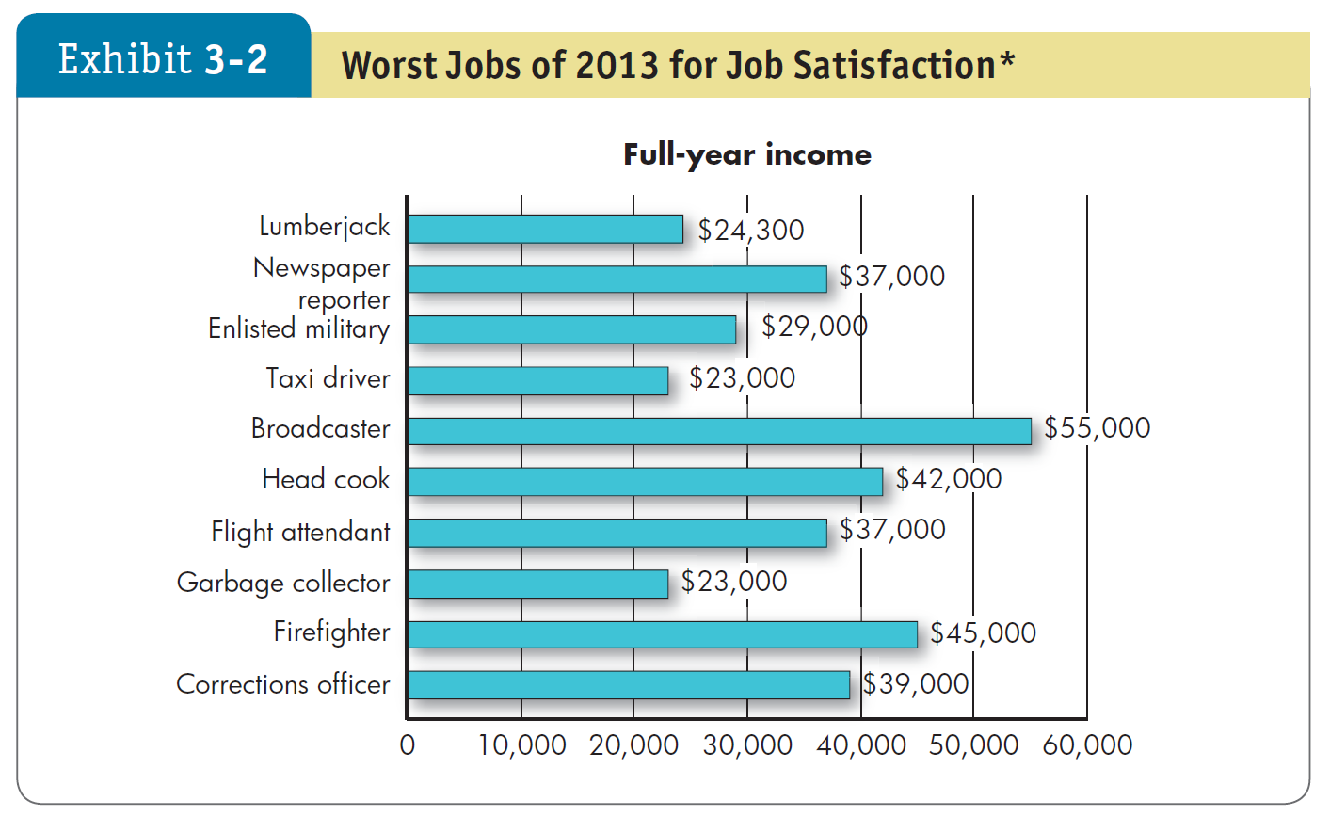



Define Job Satisfaction
LO 4
3-13
Notes:
When it comes to job satisfaction, some jobs are less attractive, as shown in Exhibit 3-2.
We have already discussed job satisfaction briefly. Now let’s dissect the concept more carefully. How do we measure job satisfaction? What causes an employee to have a high level of job satisfaction? How do satisfied employees affect an organization? Before you answer, a look at the list of worst jobs for job satisfaction
احب شادن
You may be surprised that they are not all low-paid jobs.

Slide 14










Define Job Satisfaction
LO 4
Job Satisfaction
A positive feeling about a job resulting from an evaluation of its characteristics.
Two approaches for measuring job satisfaction are popular
The single global rating.
The summation of job facets.
3-14
Notes:
As we have discussed, job satisfaction is defined as a positive feeling about a job resulting from an evaluation of its characteristics.
Jobs require interacting with co-workers and bosses, following organizational rules and policies, determining the power structure, meeting performance standards, living with less-than-ideal working conditions, adapting to new technology, and so forth. satisfaction with the job is thus a complex summation of many discrete elements.
There are multiple ways to measure job satisfaction, but two approaches are popular.
The single global rating approach is a response to one question, such as, “All things considered, how satisfied are you with your job?” Respondents circle a number between 1 and 5 on a scale from “highly satisfied” to “highly dissatisfied.”
The second approach, the summation of job facets, is more sophisticated. It identifies key elements in a job, such as the nature of the work, supervision, present pay, promotion opportunities, and relations with coworkers. Respondents rate these on a standardized scale, and researchers add the ratings to create an overall job satisfaction score.
The single global rating method isn’t very time consuming, while the summation of job facets helps managers zero in on problems and deal with them faster and more accurately.

Slide 15
Define Job Satisfaction
LO 4
How satisfied are people in their jobs?
Over the last 30 years, employees in the U.S. and most developed countries have generally been satisfied with their jobs.
With the recent economic downturn, more workers are less satisfied.
Satisfaction levels differ depending on the facet involved.
There are cultural differences in job satisfaction.
3-15
Notes:
Job satisfaction levels can remain quite consistent over time, U.S. average job satisfaction levels were consistently high from 1972 to 2006.
Research shows that over the past 30 years, the majority of U.S. workers have been satisfied with their jobs. However, the recent economic downturn has generated a dramatic drop-off in satisfaction levels, with just half of workers reporting feeling satisfied now.
In late 2007, the economic contraction precipitated a drop-off in job satisfaction; the lowest point was in 2010, when 42.6 percent of U.S. workers re- ported satisfaction with their jobs.25 Approximately 47.7 percent of U.S. workers reported satisfaction with their jobs in 2014
The exhibits on the following two slides illustrate additional details regarding differences among job satisfaction, including the affect of particular facets and cultural context.

Slide 16
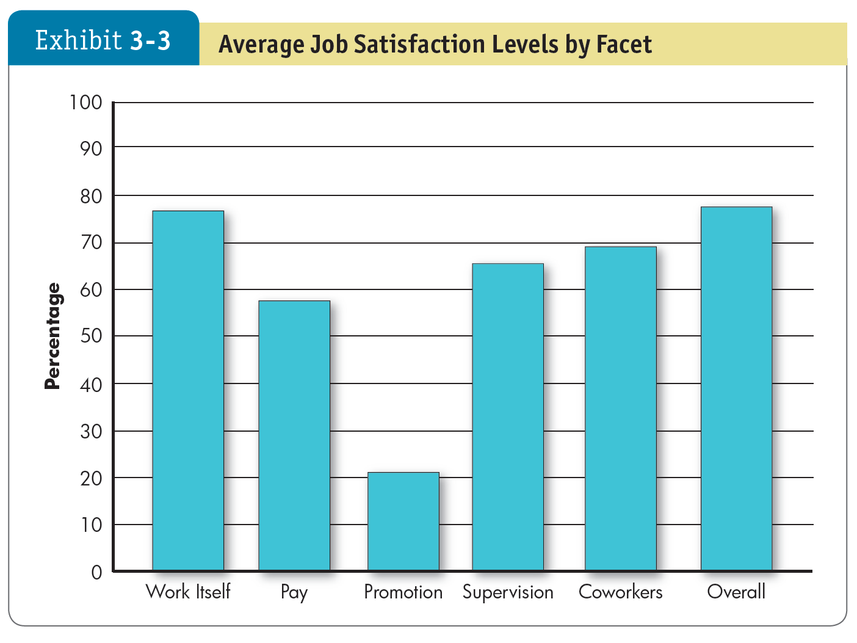
Define Job Satisfaction
LO 4
3-16
Notes:
As shown here in Exhibit 3-3, people have typically been more satisfied with their jobs overall, with the work itself, and with their supervisors and coworkers, than they have been with their pay and promotion opportunities.
The facets of job satisfaction levels can vary widely. As shown in Exhibit 3-3, people have typically been more satisfied with their jobs overall, the work itself, and their supervisors and co-workers than they have been with their pay and promotion opportunities.

Slide 17
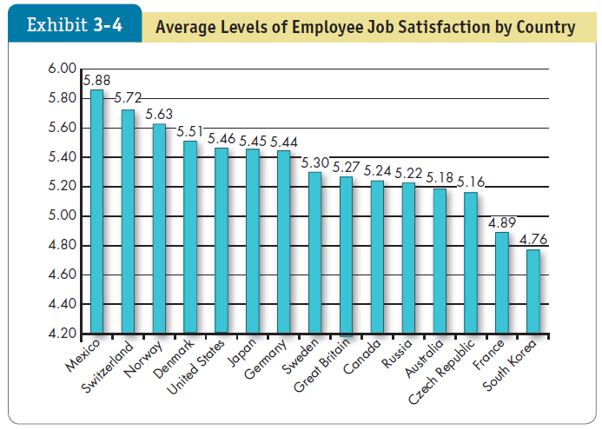
Define Job Satisfaction
LO 4
3-17
Notes:
Exhibit 3-4 provides results of a global study of job satisfaction levels of workers in 15 countries. Mexico and Switzerland report the highest levels of job satisfaction.
The results of a global study of job satisfaction levels of workers in 15 countries, with the highest levels in Mexico and Switzerland
Do employees in these cultures have better jobs? Or are they simply more positive (and less self-critical)? Conversely, the lowest score in the study was for South Korea. Autonomy is low in South Korean culture, and businesses tend to be rigidly hierarchical in structure. Does this make for low job satisfaction?It is difficult to discern all the factors influencing the scores, but considering how businesses are responding to changes brought on by globalization may give us clues.

Slide 18




Summarize the Main Causes of Job Satisfaction
LO 5
What causes job satisfaction?
1) Job conditions: The intrinsic nature of the work itself, social interactions, and supervision are important predictors of job satisfaction.
2) Personality: People who have positive core self-evaluations, who believe in their inner worth and basic competence, are more satisfied with their jobs than those with negative core self-evaluations.
3) Pay
Notes:
1) Interesting jobs that provide training, variety, independence, and control satisfy most employees. There is also a strong correspondence between how well people enjoy the social context of their workplace and how satisfied they are overall. Interdependence, feedback, social support, and interaction with coworkers outside the workplace are strongly related to job satisfaction even after accounting for characteristics of the work itself.
Managers also play a big role in employees’ job satisfaction. Employees who feel empowered by their leaders experience higher job satisfaction.
Research in Israel suggested that a manager’s attentiveness, responsiveness, and support increase the employee’s job satisfaction
job conditions—especially the intrinsic nature of the work itself, social interactions, and supervision—are important predictors of job satisfaction. Although each is important, and although their relative value will vary across employees, the intrinsic nature of the work is most important.
2) Personality also plays a role in job satisfaction. Research has shown that people who have positive core self-evaluations, who believe in their inner worth and basic competence, are more satisfied with their jobs than those with negative core self-evaluations.
high levels of both CSE and career commitment may realize particularly high job satisfaction
3) Pay also has an influence on job satisfaction but not as much as one might think. We’ll look at it in the next slide.
Pay does correlate with job satisfaction and overall happiness for many people, but the effect can be smaller once an individual reaches a standard level of comfortable living.

Slide 19
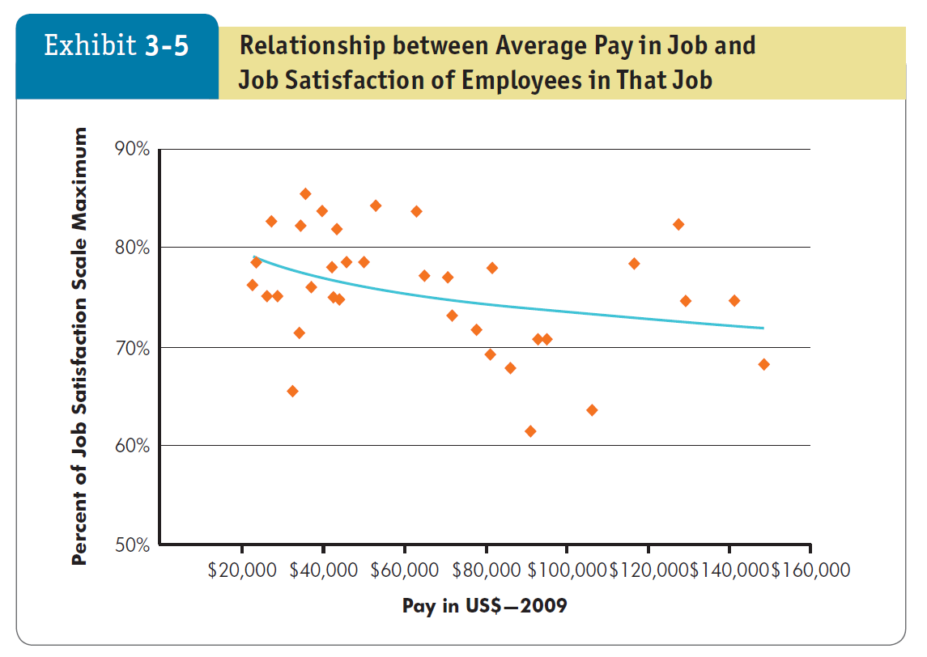
Summarize the Main Causes of Job Satisfaction
LO 5
3-19
Notes:
Exhibit 3-5 shows the relationship between the average pay for a job and the average level of job satisfaction. Once an individual reaches a level of comfortable living (in the United States, that occurs at about $40,000 a year, depending on the region and family size), the relationship between pay and job satisfaction virtually disappears.
Money does motivate people , but what motivates us is not necessarily the same as what makes us happy.

Slide 20







Summarize the Main Causes of Job Satisfaction
LO 5
Corporate Social Responsibility (CSR)
4) Corporate social responsibility (CSR):
self-regulated actions to benefit society or the environment beyond what is required by law.
Includes environmental sustainability initiatives, nonprofit work, and charitable giving.
Increasingly affects employee job satisfaction.
CSR is particularly important for Millennials.
Not everyone finds value in CSR.
Notes:
An
The relationship between CSR and job satisfaction is particularly strong for Millennials. The next generation of employees is seeking out employers that are focused on the triple bottom line: people, planet, and revenue,
Although the link between CSR and job satisfaction is strengthening, not all employees find value in CSR. Therefore, organizations need to address a few issues in order to be most effective:
First, not all projects are equally meaningful for every person’s job satisfaction, yet participation for all employees is sometimes expected.
Second, some organizations require employees to contribute in a prescribed manner. pressuring people to go “above and beyond” in ways that are not natural for them can burn them out for future CSR projects and lower their job satisfaction, particularly when CSR projects provide direct benefits to the organization (such as positive press coverage).
Third, CSR measures can seem disconnected from the employee’s actual work, providing no increase to job satisfaction.
CSR is a needed, positive trend of accountability and serving. It can also significantly contribute to increased employee job satisfaction when managed well.

Slide 21









Outcomes of Job Satisfaction
LO 6
Job Performance
Happy workers are more likely to be productive workers.
OCB
People who are more satisfied with their jobs are more likely to engage in OCB.
Customer Satisfaction
Satisfied employees increase customer satisfaction and loyalty.
Life Satisfaction
Research shows that job satisfaction is positively correlated with life satisfaction.
Notes:
Now, let’s look at specific outcomes of job satisfaction related to job performance, OCB, customer satisfaction, and life satisfaction.
Job Performance: Happy workers are more likely to be productive workers—the evidence suggests that productivity is likely to lead to satisfaction. relationship between job satisfaction and job performance (the correlation is quite robust)
Organizational Citizenship Behavior (OCB): It seems logical to assume job satisfaction should be a major determinant of an employee’s organizational citizenship behavior (OCB). Finally, research shows that when people are more satisfied with their jobs, they are more likely to engage in OCBs. people talking positively about their organizations, helping others, and going beyond the normal expectations of their jobs
Customer Satisfaction: Evidence indicates that satisfied employees increase customer satisfaction and loyalty.
Life Satisfaction: Research in Europe indicated that job satisfaction is positively correlated with life satisfaction, and your attitudes and experiences in life spill over in to your job approaches and experiences. Furthermore, life satisfaction decreases when people become unemployed. according to research in Germany, and not just because of the loss of income. For most individuals, work is an important part of life, and therefore it makes sense that our overall happiness depends in no small part on our happiness in our work (our job satisfaction)

Slide 22
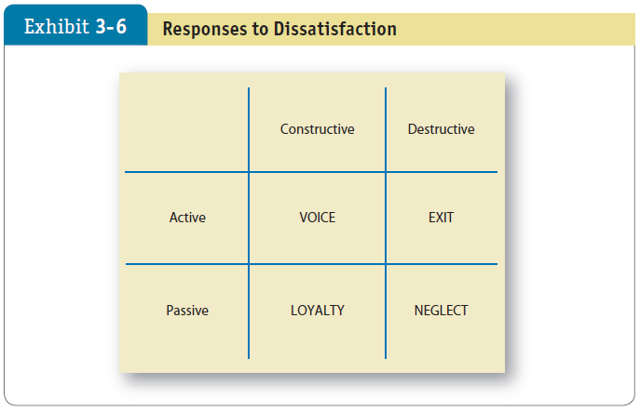




Four Employee Responses to Dissatisfaction
LO 6
Notes:
What happens when employees dislike their jobs? The exit–voice–loyalty–neglect framework shown in Exhibit 3-6 is helpful for understanding the consequences of dissatisfaction.
The exhibit illustrates employees’ four responses to job dissatisfaction, which differ along two dimensions: constructive/destructive and active/passive.
The responses are as follows:
Exit. The exit response directs behavior toward leaving the organization, including looking for a new position or resigning. (Total loss to the organization of employee knowledge, skills, abilities, and other characteristics)
Voice. The voice response includes actively and constructively attempting to improve conditions, including suggesting improvements, discussing problems with superiors, and undertaking union activity.
Loyalty. The loyalty response means passively but optimistically waiting for conditions to improve, including speaking up for the organization in the face of external criticism and trusting the organization and its management to “do the right thing.”
Neglect. The neglect response passively allows conditions to worsen and includes chronic absenteeism or lateness, reduced effort, and increased error rate.
Exit and neglect behaviors are linked to performance variables such as productivity, absenteeism, and turnover.
voice and loyalty—constructive behaviors that allow individuals to tolerate unpleasant situations or improve working conditions.
As helpful as this framework is, it’s quite general.

Slide 23



Four Employee Responses to Dissatisfaction
LO 6
Counterproductive Work Behavior (CWB)
Counterproductive work behavior: actions that actively damage the organization, including stealing, behaving aggressively toward coworkers, or being late or absent.
Absenteeism: the more satisfied you are, the less likely you are to miss work.
Turnover: a pattern of lowered job satisfaction is the best predictor of intent to leave.
Managers Often “Don’t Get It”
Notes:
In addition, we can look at job dissatisfaction by exploring counterproductive work behavior. Substance abuse, stealing at work, undue socializing, gossiping, absenteeism, and tardiness are examples of behaviors that are destructive to organizations.
They are indicators of a broader syndrome called counterproductive work behavior (CWB), also termed deviant behavior in the workplace, or simply employee withdrawal. CWB doesn’t just happen—the behaviors often follow negative and sometimes longstanding attitudes. Generally, job dissatisfaction predicts CWB. People who are not satisfied with their work become frustrated, which lowers their performance and makes them more likely to commit CWB. Other research suggests that, in addition to vocational misfit (being in the wrong line of work), lack of fit with the organization (working in the wrong kind of organizational culture) also predicts CWBs. CWB is an emotional reaction to perceived unfairness, a way to try to restore an employee’s sense of equity exchange.
As a manager, you can take steps to mitigate CWB. You can poll employee attitudes, for instance, and identify areas for workplace improvement. If there is no vocational fit, the employee will not be fulfilled, so you can screen for that. Tailoring tasks so a person’s abilities and values can be exercised should increase job satisfaction and reduce CWB. Furthermore, creating strong teams, integrating supervisors with them, providing formalized team policies, and introducing team-based incentives may help lower the CWB “contagion” that lowers the standards of the group.
Absenteeism: We find a consistent negative relationship between satisfaction and absenteeism. The more satisfied you are, the less likely you are to miss work.
Turnover: Satisfaction is also negatively related to turnover, but the correlation is stronger than what we found for absenteeism.
Workplace Deviance: Job dissatisfaction predicts unionization, stealing, undue socializing, and tardiness. If employees don’t like their work environment, they will respond somehow.
Managers Often “Don’t Get It”: It should come as no surprise that job satisfaction can affect the bottom line. Regular surveys can reduce gaps between what managers think employees feel and what they really feel.
many managers are unconcerned about employee job satisfaction. Others overestimate how satisfied employees are, so they don’t think there’s a problem when there is.
Regular surveys can reduce gaps between what managers think employees feel and what they really feel

Slide 24
Implications for Managers
Of the major job attitudes – job satisfaction, job involvement, organizational commitment, perceived organizational support (POS), and employee engagement – remember that an employee’s job satisfaction level is the best single predictor of behavior.
Pay attention to your employees’ job satisfaction levels as determinants of their performance, turnover, absenteeism, and withdrawal behaviors.
Notes:
Creating a satisfied workforce is not a guarantee of successful performance, but managers should make it a priority as much as possible. In particular, managers should:
Of the major job attitudes—job satisfaction, job involvement, organizational commitment, perceived organizational support (POS), and employee engagement—remember that an employee’s job satisfaction level is the best single predictor of behavior.
Pay attention to employees’ job satisfaction levels as determinants of their performance, turnover, absenteeism, and withdrawal behaviors.

Slide 25
Implications for Managers
Measure employee job attitudes objectively and at regular intervals in order to determine how employees are reacting to their work.
To raise employee satisfaction, evaluate the fit between the employee’s work interests and the intrinsic parts of his/her job to create work that is challenging and interesting to the individual.
Consider the fact that high pay alone is unlikely to create a satisfying work environment.
Notes:
Measure employee job attitudes objectively and at regular intervals in order to determine how employees are reacting to their work.
Evaluate the fit between the employee’s work interests and the intrinsic parts of his/her job to create work that is challenging and interesting to the individual.
Consider the fact that high pay alone is unlikely to create a satisfying work environment.

